Slide 1
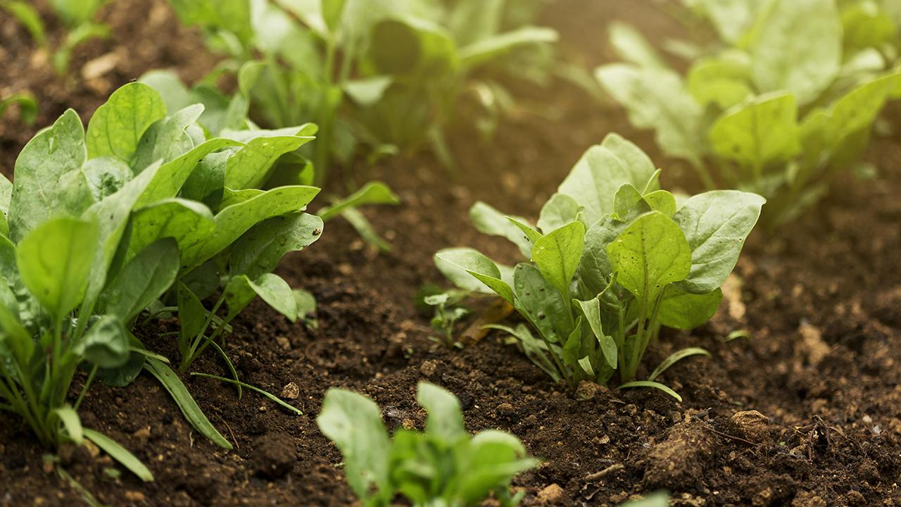

CROP RECOMMENDATION SYSTEM
Department of CSE AI
Group 4
Team:
Alok Kumar Mishra (202401100300029)
Aman Singh Yadav (202401100300031)
Anushka Shakya (202401100300060)
Akshit Vats(202401100300026)
Arnav Bhardwaj (202401100300062)
Submitted to: Mr. Bikki Kumar

Slide 2
Problem Statement
Farmers struggle to choose the most suitable crop under varying soil and weather conditions, resulting in poor yield.
The Challenge
How an we leverage artificial intelligence to recommend the most suitable crop based on soil and weather conditions, maximizing productivity and sustainability?
The Need

Slide 3
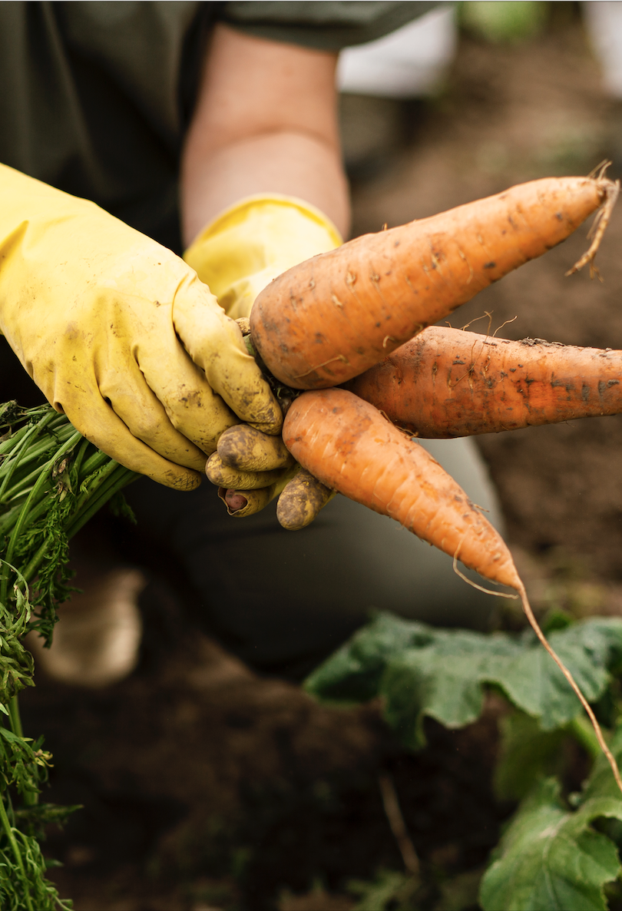
Objectives
Primary Goal: Build an intelligent, data-driven system to recommend crops using classification techniques.
Sub-objectives:
Enhance yield predictability
Minimize resource wastage (water, fertilizer)
Empower farmers with smart decision-making tools
Drive sustainable agricultural practices using technology

Slide 4
Dataset & Processing
Dataset: Crop_recommendation.csv
• Features: N, P, K, temperature, humidity, pH, rainfall
• Target: Crop label (22 classes)
Preprocessing Steps:
• Checked for nulls and duplicates
• Converted types as needed
• Feature selection & cleaning
• Normalization for scaling

Slide 5
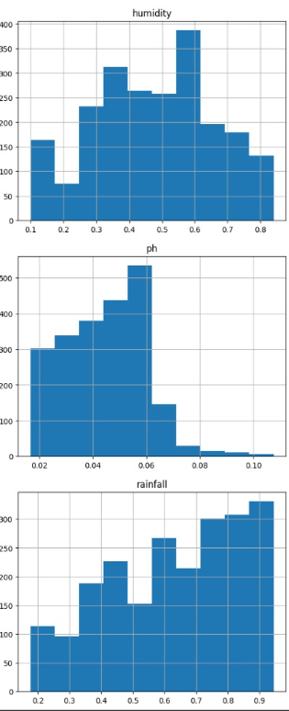
Graphs & Visuals — 1 (Feature Distributions)
What we visualized:
• Histograms of N, P, K, temp, humidity, pH, rainfall
• Distplot & displot of pH values
• Catplot for rainfall distribution
Insights:
• Most features follow normal-like or skewed distributions
• Some clusters are visible, aiding classification

Slide 6
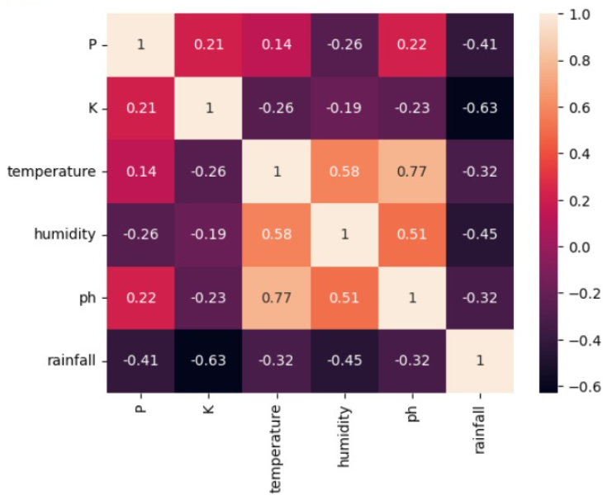
Graphs & Visuals — 2 (Relationships)
Plots Displayed:
• Heatmap showing correlations between features
• Pairplot highlighting feature interactions
• Relplot showing pH vs rainfall vs temp relationships
Insight:
• Temp, pH, and humidity show moderate-to-strong relationships with crop selection.

Slide 7
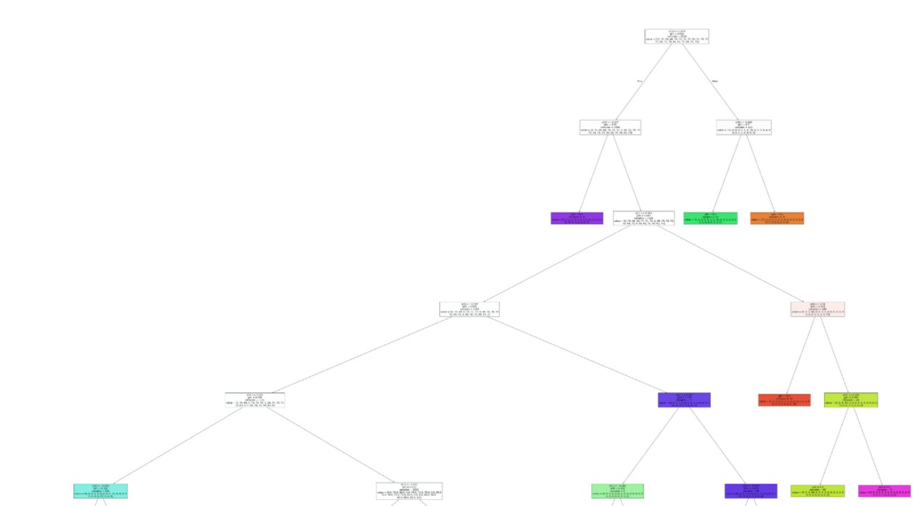
Graphs & Visuals — 3 (Model Visualization)
Model Evaluation Graphs:
• Bar Plot comparing model accuracies
• Decision Tree Plot showing feature splits
Conclusion:
• Random Forest performs best (~99%)
• Decision Tree helps interpret feature importance

Slide 8
Algorithms Used
Algorithm | Concept | Accuracy
Logistic Regression | Linear Classifier | ~94%
K-Nearest Neighbours | Distance-based Classification | ~98%
Decision Tree | Rule-based splits | ~96%
Random Forest | Ensemble of Trees | ~99.5%

Slide 9
Evaluation & Comparison
Metrics Used:
• Accuracy Score
• Confusion Matrix
• F1 Score (implicit through model comparison)
Outcome:
• Random Forest gives highest accuracy
• Models show minimal overfitting
• Predictions match ground truth well

Slide 10
Conclusion
Closing Thoughts:
This system integrates data science with agriculture, offering a smart way to recommend crops using machine learning models trained on real soil and climate data.
“From soil to solution — AI-driven agriculture begins here.”

